Slide 1
Adapted from @the.happy.educator on Instagram
1
2
24
3
23
4
22
5
21
6
20
7
19
8
18
9
17
10
16
11
15
12
14
13

Slide 2
1. Tweet tweet
Take/create a twitter card and write a tweet about what you have learned today or what you would like more help with.

Slide 3
2. Question time
?
Write down a question about today’s lesson and your partner will answer it.

Slide 4
3. Truths and a lie
Tell your partner two facts you learnt today and 1 lie. Does your partner know which ones are true and which are false?
This Photo by Unknown Author is licensed under CC BY-SA

Slide 5
4. Two stars and a wish
Write down two things you learned from today’s lesson and one thing you would like more help with.

Slide 6
5. Be the teacher
??
Write down 2 questions about today’s lesson and I’ll use them as a starter for the next lesson.

Slide 7
6. Show me!
Take a look!!
I know how to…
Show me something you have learned today on your whiteboard/book
This Photo by Unknown Author is licensed under CC BY

Slide 8
7. Attention grabber
Write a newspaper headline that shows what you have learned today. Earn extra points for writing a paragraph too!
This Photo by Unknown Author is licensed under CC BY

Slide 9
8. Hot seat
One person will answer questions from the rest of the class about the lesson. Don’t worry if you don’t know the answer, we are all here to help.
Remember, if you are asking a question you need to know the answer.

Slide 10
9. Be the teacher
Ask the class some questions about what you have learned today. Remember you need to know the answers!
This Photo by Unknown Author is licensed under CC BY-NC-ND

Slide 11
10. The answer is…
?
Write down 3 answers and get your partner to create questions for them.

Slide 12
11. Stick person
Draw a stick person.
Beside their head write one thing you learned today.
Next to the stomach write how the lesson made you feel.
Next to the feet, write your next steps.

Slide 13
12. Gimme 5!
Write down 4 key things you learned today.
Write down 1 thing you would like more help with.

Slide 14
13. Then and now
Write down something you know now that you didn’t know at the start of the lesson.
This Photo by Unknown Author is licensed under CC BY-ND

Slide 15
14. VIP – very important point!
What is the most important thing you have learned today? Remember to think about why it is the most important.
This Photo by Unknown Author is licensed under CC BY-NC

Slide 16
15. Alien invasion
An alien has invaded our classroom. How would you explain what you learned today to the alien?

Slide 17
16. Out in the world
How could you use what you learned today outside of school?

Slide 18
17. Take it home
What are the key 3 things you would tell someone at home about today’s lesson?

Slide 19
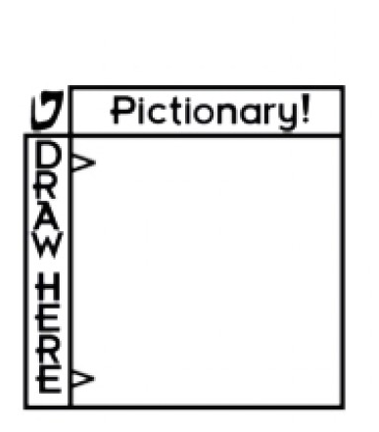
18. Pictionary
Can you draw a picture of what you learned today? You only have 5 minutes so don’t be too detailed!
This Photo by Unknown Author is licensed under CC BY-NC-ND

Slide 20
19. Be the Prime Minister
Can you make a short speech to your partner about what you learned today? Remember to make it interesting!
This Photo by Unknown Author is licensed under CC BY-SA

Slide 21
20. No.1 vlogger
If you were to make a vlog about what you learned today, what key points would you make?
This Photo by Unknown Author is licensed under CC BY-SA

Slide 22
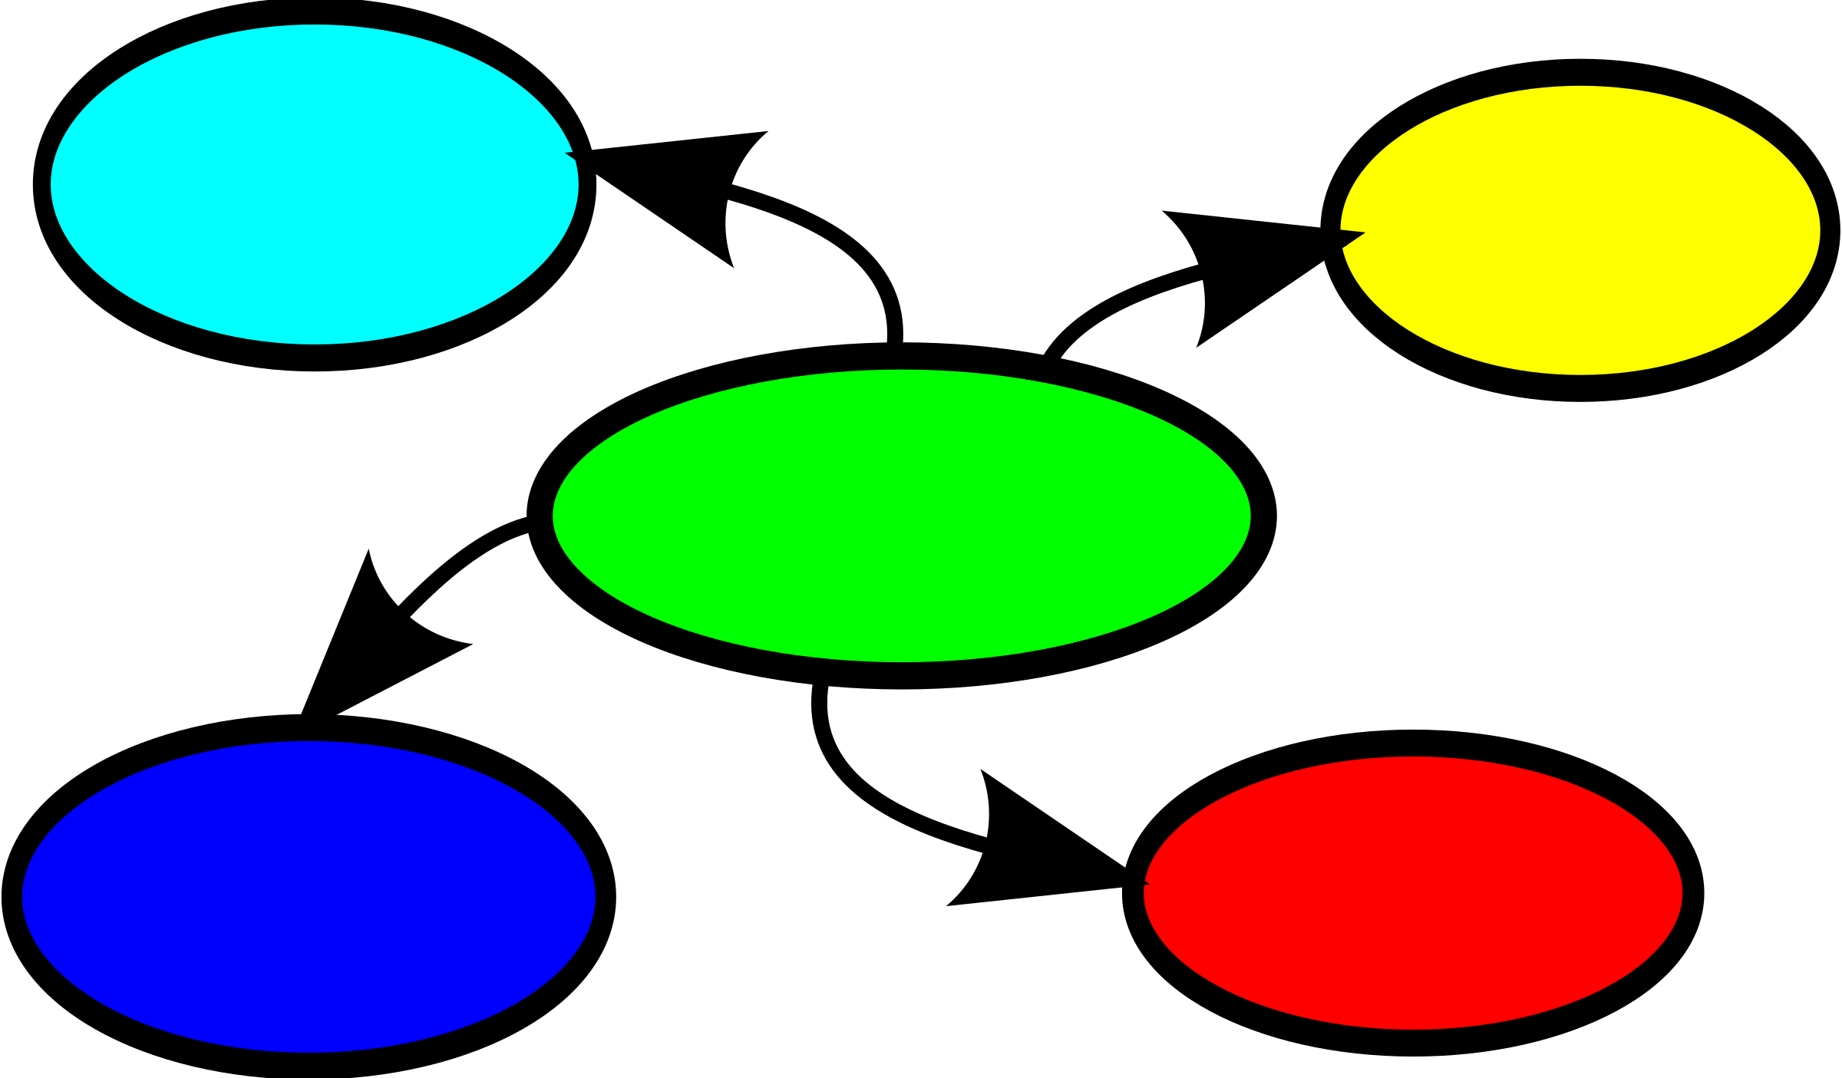
21. Mind map
Create a mind map showing what you have learned today.

Slide 23
22. Textbook
A textbook is being published all about today’s lesson. Can you design a front cover for it?
This Photo by Unknown Author is licensed under CC BY-NC-ND

Slide 24
23. Chat to your partner
Find out 3 things that your partner learned today. Listen carefully so you can tell the class.

Slide 25
24. Key words
Create a dictionary definition for 2 keywords from today’s lesson.
This Photo by Unknown Author is licensed under CC BY-SA

